Slide 2
Top of the Table: Winning with Table Calculations
Matt Peterson & Tim Pritchard
Product Consultants
Tableau

Slide 3

Matt Peterson

Slide 4

Tim Pritchard

Slide 5
Agenda
+ Introduction
+ Running Total
+ Percent of Total
+ Rank
+ Break!
+ Moving Average
+ Percent Difference
+ Window Functions
+ Waterfall Charts
+ Edit Table Calculations

Slide 6
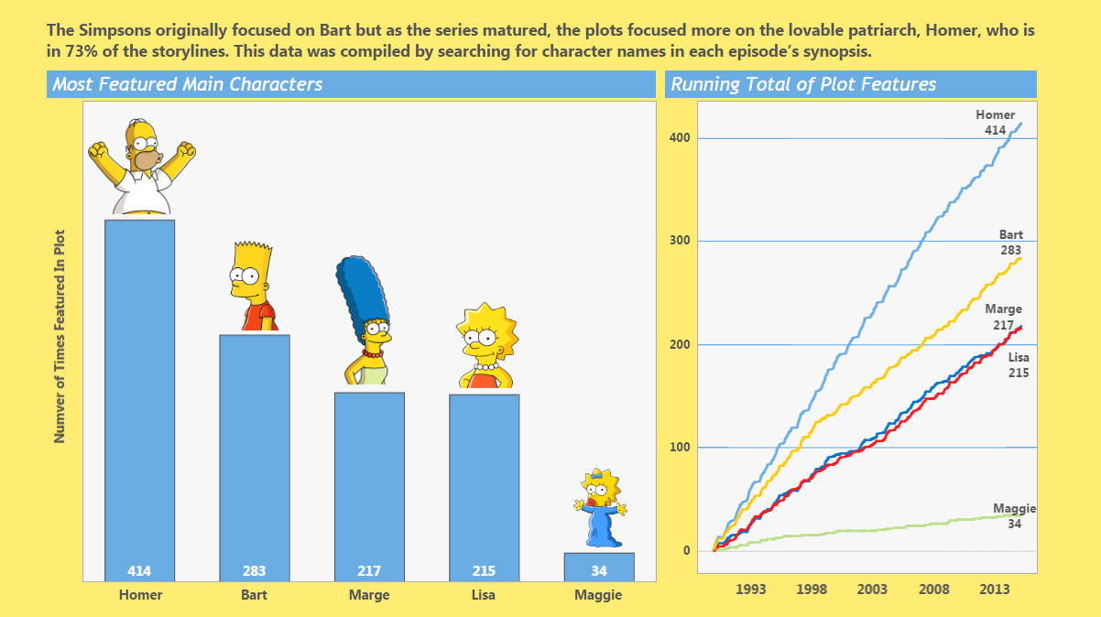
The Case for Table Calculations
Table Calculations are a powerful tool to help understand data and easily do the math for the consumer – visually!
This Tableau Public viz by David Newman shows a running sum of time each Simpson character is featured in the main plot.
Credit: David Newman Link: https://public.tableau.com/s/gallery/visualizing-simpsons

Slide 7
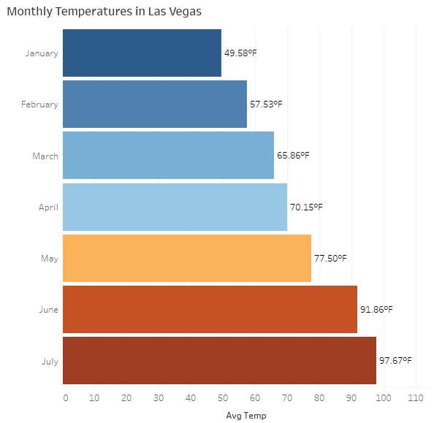
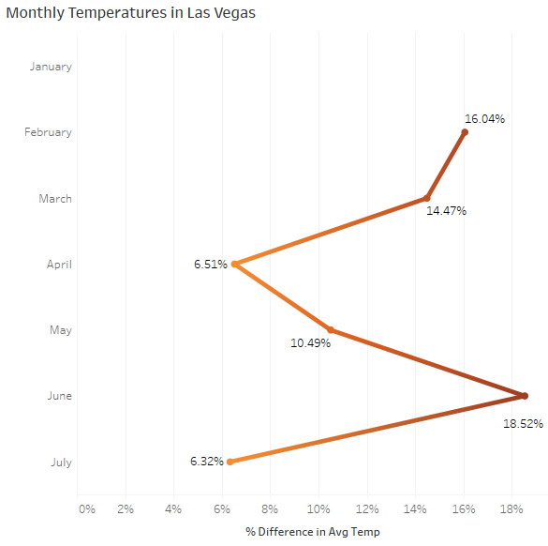
What Is a Table Calculation?
A type of calculation performed locally in Tableau by comparing multiple values within a visualization
The below views show mean temperatures per month in Las Vegas, and the percent change from month to month.

Slide 8
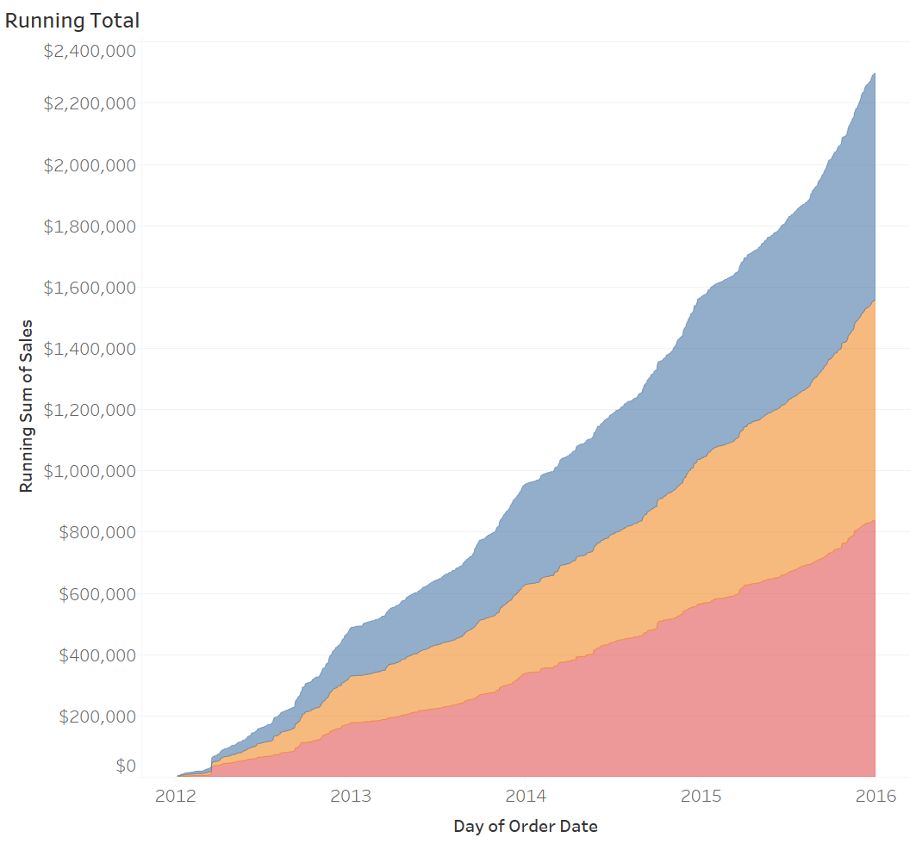
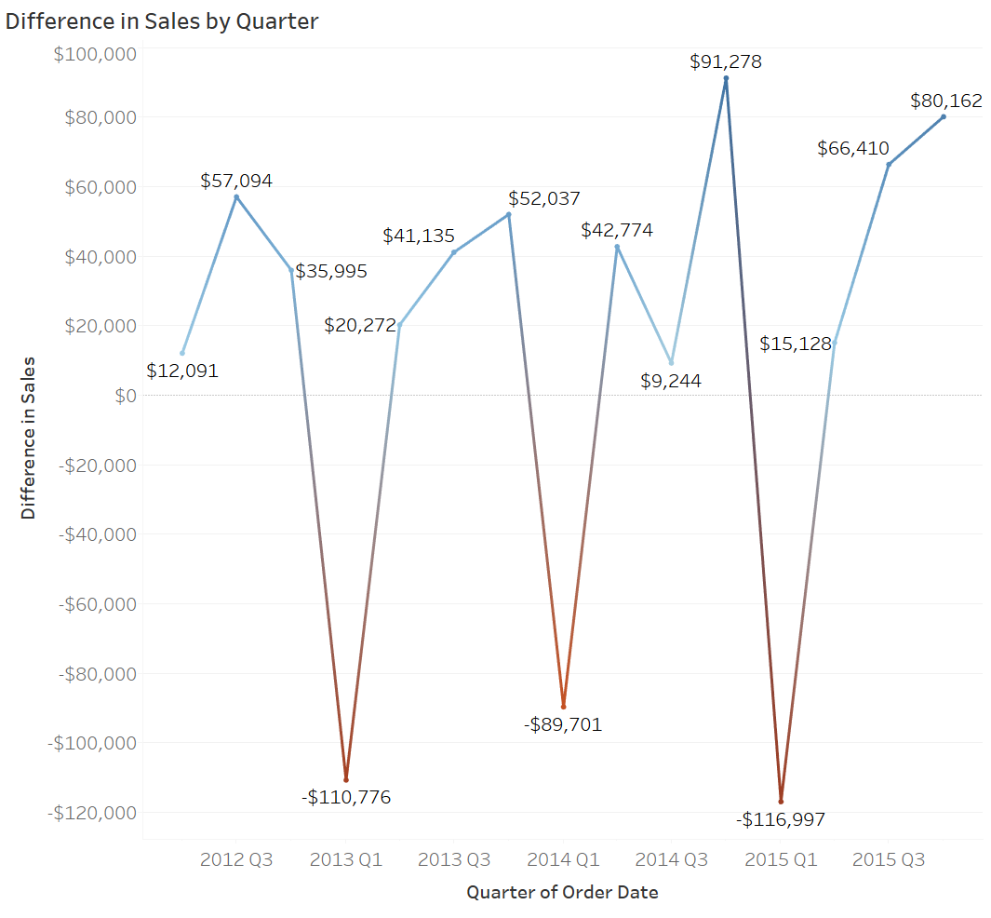
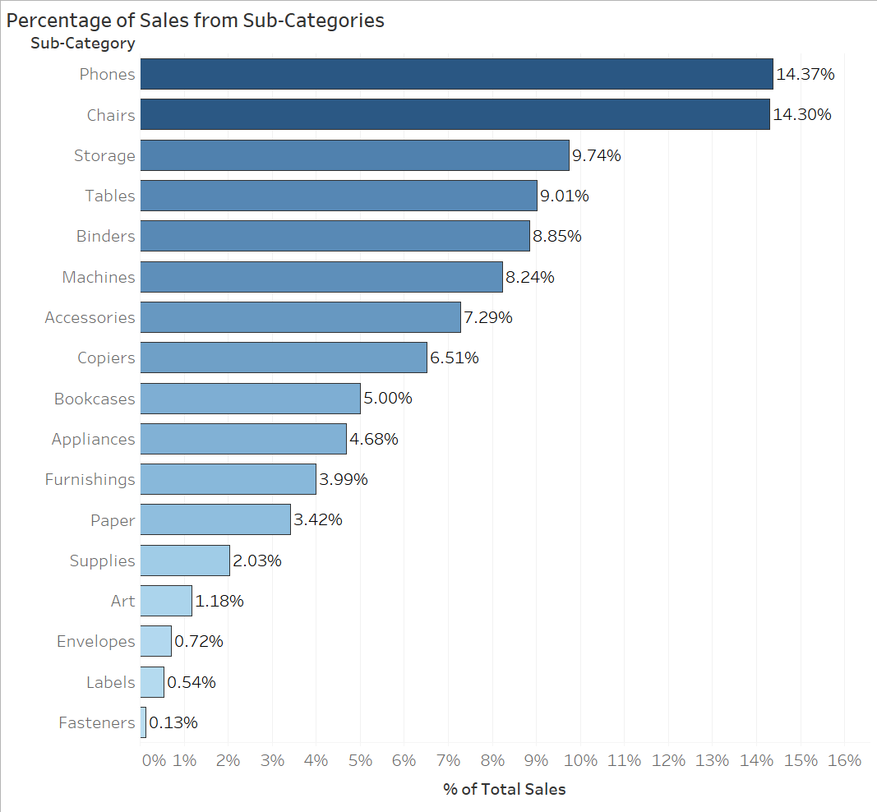
Common Examples
Running Total
Difference
Percent of Total
Running total of Sales over Time
Difference in Sales across Quarters
Percent of Sales across Sub-Categories

Slide 9
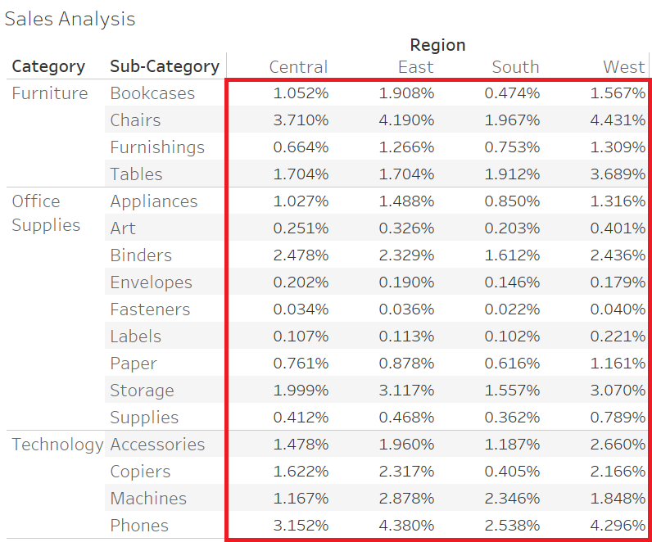
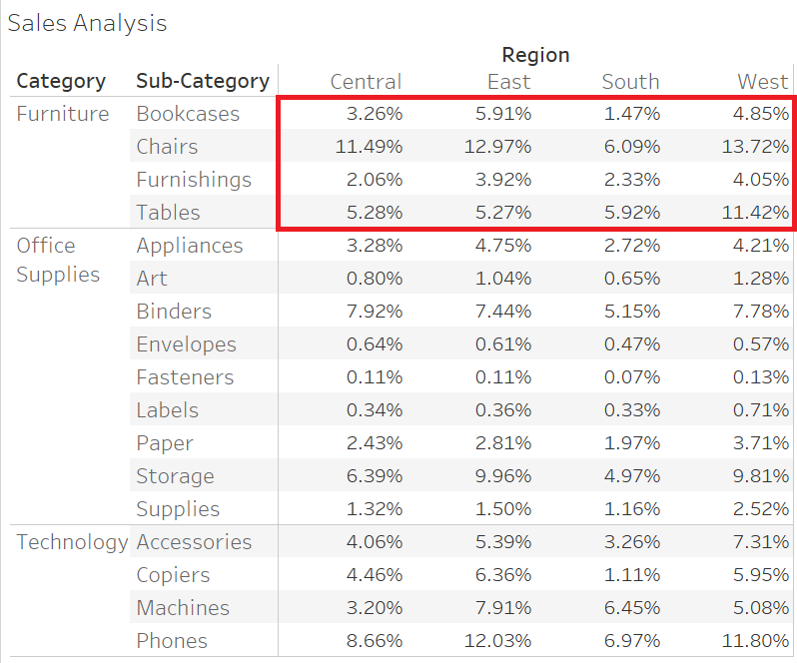
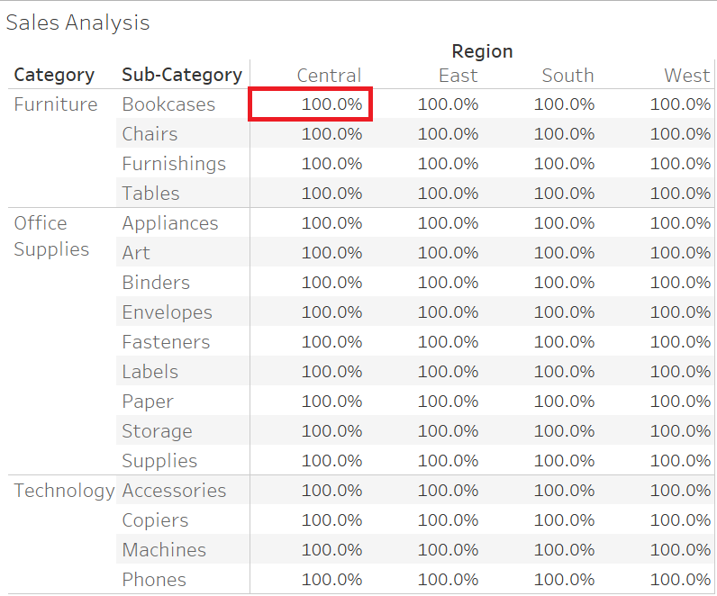
Terminology
Table
Pane
Cell

Slide 10
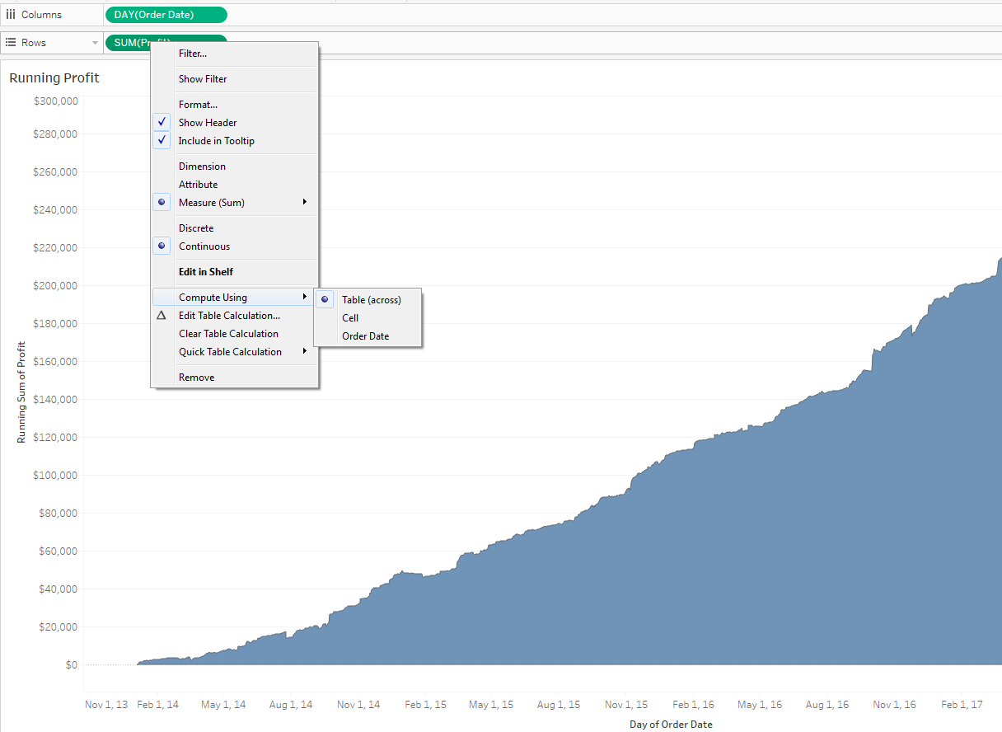
Terminology
You don’t always have Panes!
Do you have 2 or more dimensions on either Rows OR Columns?
This view showing total Profit over time doesn’t have 2 or more dimensions, and therefore doesn’t have panes.

Slide 11
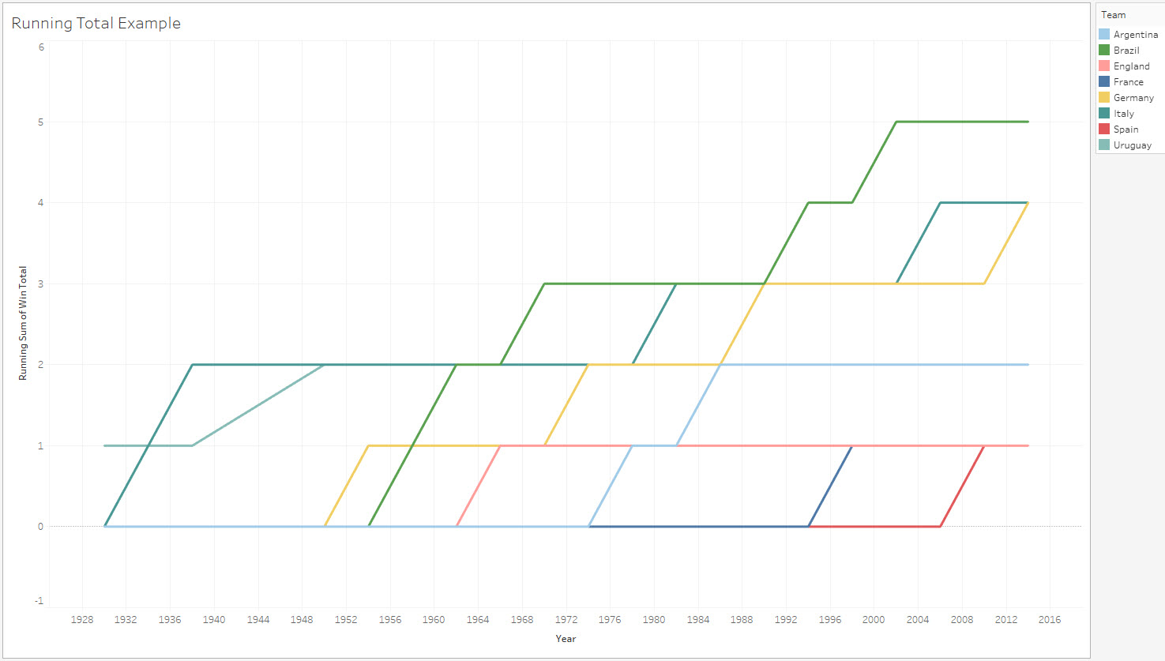
Running Total
Why would I use Running Total?
Let Tableau “Do the Math” accumulating towards a Grand or Sub-Total
Make sense of very granular historical data
Common Uses
Financial Data – Creating a Balance Sheet or Waterfall Chart
Show History of Growth
Group Example
Which country has won the most World Cups (and how many?)

Slide 12
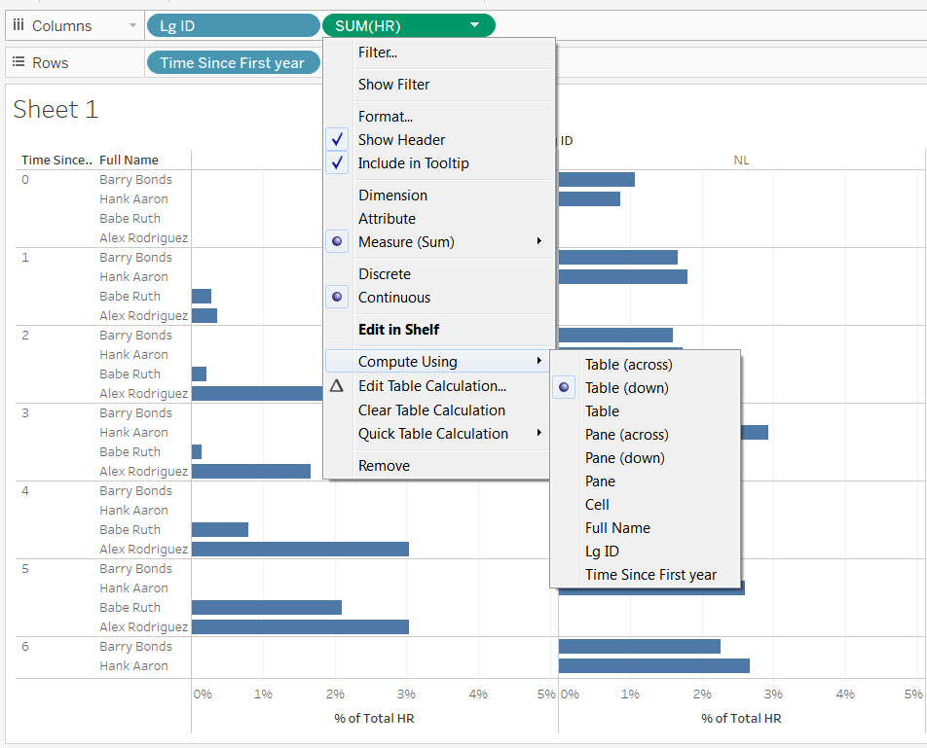
Compute Using
So many options!

Slide 13
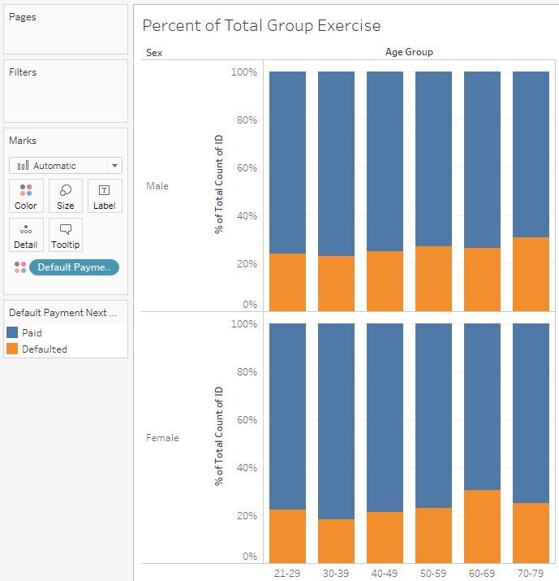
Percent of Total
Why would I use Percent of Total?
Understand the contribution of one slice compared to the entire pie.
Common Uses
Labeling Marks in Tree Maps, Pie Charts, etc., to see percent of each section
Group Example
Across all age groups and both genders, which cohort is least likely to default on a payment?

Slide 14
Percent of Total
Now it’s your turn to use Percent of Total
Challenge Questions
How have game revenues and slot revenues contributed to total casino revenue on the Las Vegas strip over time?
Advanced - Which State has the highest percentage of its dams classified as "High Hazard" dams?

Slide 15
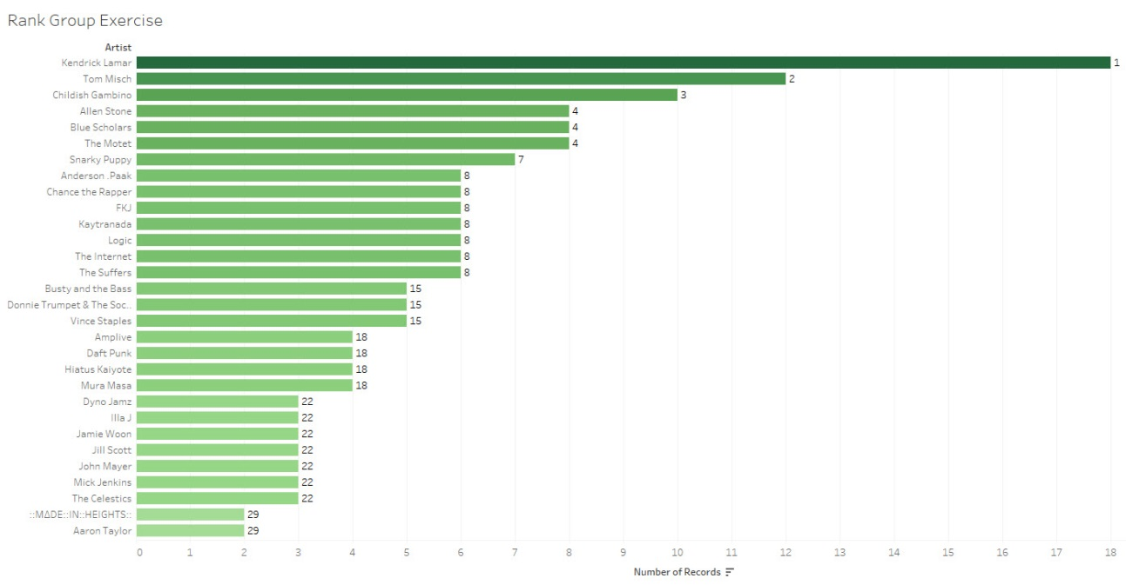
Rank
Why would I use Rank?
Does the one click sort button always work?
Can I use Rank as a filter?
Common Uses
Sales Data – Ranking Top Sales by a Dimension
Race Data – Ranking Times by Age Groups
Group Example
In this example, we can take Matt’s Spotify Data and sort each artist by sum of Number of Records. Then, using rank, we can identify where each artist falls overall in Matt's listening habits.

Slide 16
Rank
Now it’s your turn to use Rank!
Challenge Questions
Which "Place" had the most earthquakes in each year (2010 versus 2011)? Sorting normally does not return the correct results.
Advanced - Las Vegas is hot! How can we filter to show the 5 hottest days in each month? Can we add a slider and turn that into the X hottest days in each month?

Slide 17
Break Time!

Slide 18
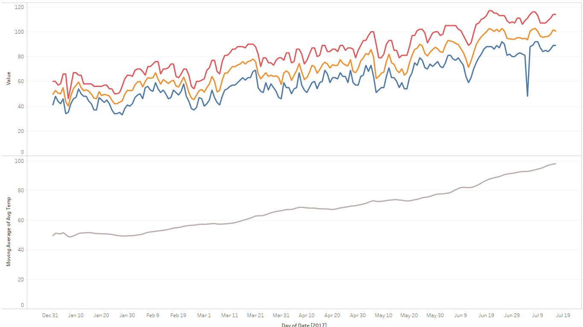
Moving Average
Why would I use Moving Average?
Common Uses
Gauging Momentum
Comparing against broader time frames
Group Example
Let's look at the Maximum, Average, and Minimum temperatures so far this year in Las Vegas. As expected, there is a bit of volatility in this data, which might better explained with a Moving Average. Let's set up this moving average below the other trends, to be able to see overall trends, and adjust the table calculation in-shelf to calculate at the month level

Slide 19
Moving Average
Now it’s your turn to use Moving Average!
Challenge Questions
Let's make a line chart displaying the number of earthquakes globally per month, and then add a moving average line chart that takes the average over the last two months (the default) in order to smooth the line and better visualize overall trends.
Advanced - Looking at our DOW Stock ticker data, let's overlay a moving average onto the Value line chart, and insert a parameter allowing us to change how many periods the Moving Average is computed over.

Slide 20
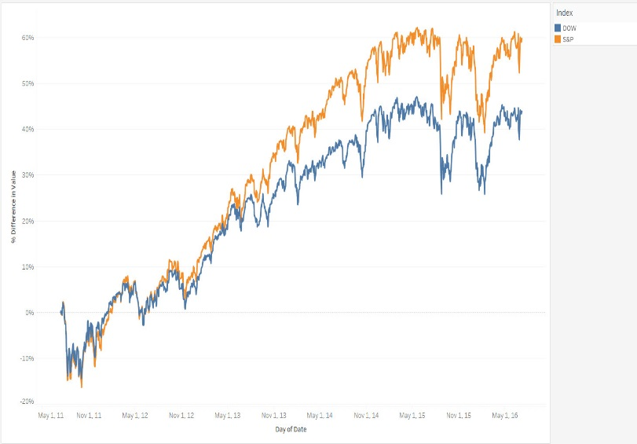
Percent Difference
Why would I use Percent Difference ?
Common Uses
Growth over time
Revenue changes like YOY/QOQ/MOM
Group Example
Which Index has the highest percent growth?

Slide 21
Percent Difference
Now it’s your turn to use Percent Difference
Challenge Questions
On which day in 2015 did the Dow see its biggest jump in value from the previous day. What percent did it increase?
Advanced - In which year did the S&P 500 growth from the previous year outperform the Dow by the greatest amount? (Using the average value for the year as the comparative metric)

Slide 22
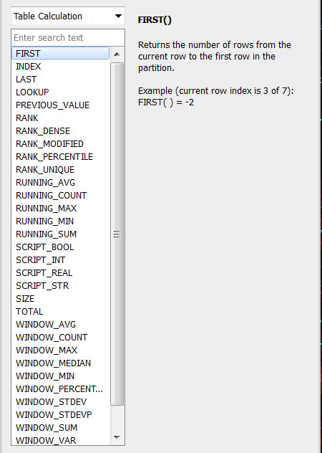
But Wait….There’s More!
We can also use table calculations in the “Create New Calculated field” window
The same rules apply but there is a longer list of options

Slide 23
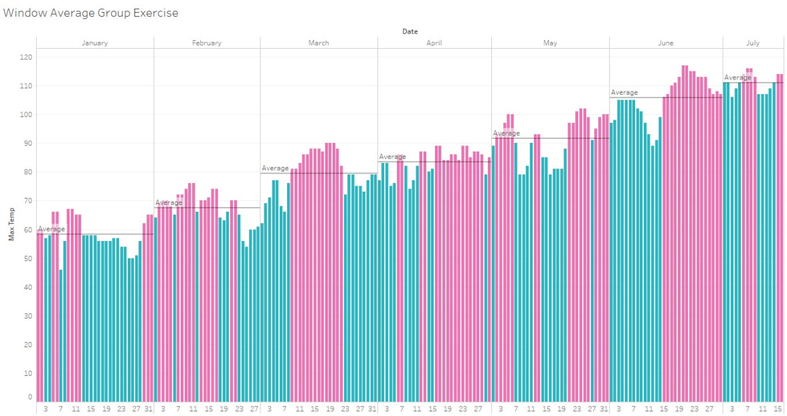
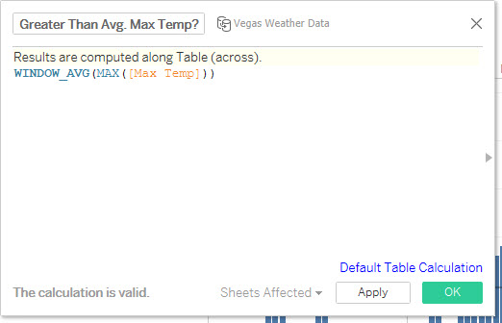
Window Functions
Why would I use Window Functions?
Common Uses
Materialize an Average line
Calculate the average of a defined window
Calculate the minimum or maximum of various cohorts
Group Example: Using Window Average with our Las Vegas weather dataset, we can write a calculation to validate whether the maximum temperature each day falls above or below the average maximum daily temperature for that particular month.

Slide 24
Window Functions
Now it’s your turn to use Window Functions!
Challenge Questions:
Let's take a look at the average age of the "High Hazard" dams for each state. Which state has the largest positive difference from the average? Which state has the largest negative difference from the average?
Advanced - Let's take a look at Vegas gaming revenue over time. Which year had the highest Game Revenue? Which year had the highest Slot Revenue? Can we show both of these in the View without visualizing Revenue Type?

Slide 25
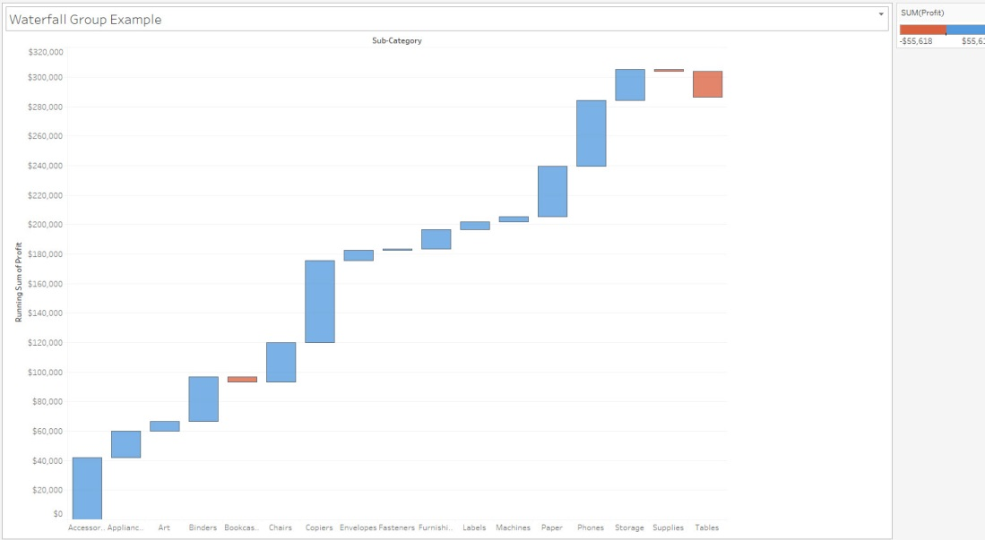
Waterfall Charts
Why would I use Waterfall Charts?
Common Uses
Visualize the progression of a measure towards the total
Frequently used to track progress over time
Group Example: Let’s simplify and use Superstore to get familiar with how to drum up a standard Waterfall Chart visualizing Profit between Subcategories.

Slide 26
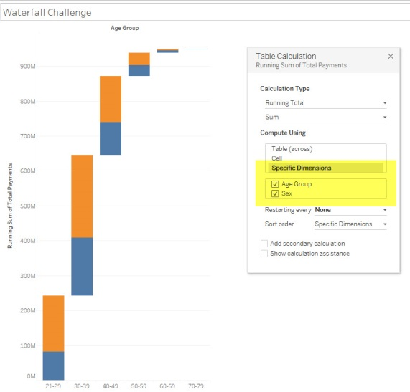
Waterfall Charts
Now it’s your turn to use Waterfall Charts!
Challenge Question:
Let’s create a Waterfall Chart that visualizes the Total Payments across each age group, broken up by Sex. How can we get the Table Calculation to compute properly with Sex in the View?

Slide 27
SESSION REPEATS
Wednesday, October 11 Top of the Table: Winning with Table Calculations
1:30pm – 4:00pm | South Pacific J

Slide 28
RELATED SESSIONS
Tuesday, October 10 Table Calcs for the Advanced Analyst
2:00pm – 4:30pm | North – Islander E
Wednesday, October 11 Table Calcs for the Advanced Analyst
1:30pm – 4:00pm | North – Islander E

Slide 29

Please complete the session survey from the Session Details screen in your TC17 app

Slide 30
Thank You For Attending!

